Slide 1
Zomato Restaurant
Analysis

Slide 2
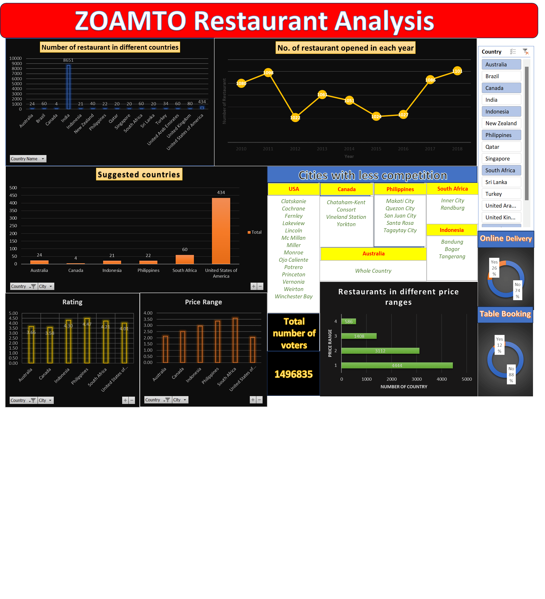

Slide 3
Restaurants in different countries

Slide 4
Countries with less competition
If we observe previous slide and go through the data insights we will find that there are six countries where there is less competition.
The countries are –
Australia
Canada
Indonesia
Philippines
South Africa
USA

Slide 5
Countries with less competition

Slide 6
Australia

Slide 7
Australia
Australia has only single restaurant in each city except Hepburn Springs, so if team want they can move forward to open restaurant in any city they want.
Average rating of food is 3.66/5
Average price range is 2.13

Slide 8
Canada

Slide 9
Canada
Canada has also very lesser number of restaurants, single restaurant in each city as provided in the data.
So the team can move forward to open restaurant in any four city.
Average rating of food is 3.58/5
Average price range is 2.50

Slide 10
Indonesia

Slide 11
Indonesia
In Indonesia cities like Bandung, Bogor & Tangerang has one or two restaurants only which seems to be less competition and more profit.
Average rating of food is 4.3/5
Average price range is 2.95

Slide 12
Philippines

Slide 13
Philippines
Here we can look for cities like Makati City , Quezon City, San Juan City, Santa Rosa & Tagaytay City which has one or two restaurant.
Average rating of food is 4.47/5
Average price range is 3.36

Slide 14
South Africa

Slide 15
South Africa
In South Africa we can go for Inner City & Randburg
Average rating of food is 4.21/5
Average price range is 3.58

Slide 16
United States of America

Slide 17
Unites States of America
If we notice country like USA the cities are either overcrowded or uncrowded , if we will go for less crowded cities then Clatskanie , Cochrane , Fernley , Lakeview, Lincoln , McMillan , Miller , Monroe , Ojo Caliente , Potrero , Princeton , Vernonia , Weirton , Winchester Bay have only single restaurant which is good for the team.
Average rating of food is 4.01/5
Average price range is 2.05

Slide 18
Competitors
With their ratings

Slide 19
Competitors
In the upcoming slides we have a list of restaurant in a particular area with high rating who would be our biggest competitors in that particular city.

Slide 20
Australia
City | Competitors | Ratings
Armidale | Whitebull Hotel | 3.5
Balingup | Taste of Balingup | 3.2
Beechworth | Bridge Road Brewers | 4.6
Dicky Beach | The Giggling Goat | 3.6
East Ballina | The Belle General | 4.1
Flaxton | Flaxton Gardens | 3.5
Forrest | Bespoke Harvest | 3.7
Hepburn Springs | La Trattoria of Lavandula | 3.8
Huskisson | 5 Little Pigs | 4.1
Inverloch | Beach Box Café | 3.7
Lakes Entrance | Funkey Monkey | 3.8
Lorn | Stillwater on Belmore | 3.6
Macedon | Mr. | 3.5
Mayfield | Star Buffet | 2.9
Middleton Beach | Three Anchors | 3.8
Montville | Poets Café | 2.4
Palm Cove | Vivo Bar and Grill | 4.4
Paynesville | Pier 70 | 2.6
Penola | DiVine | 3.4
Phillip Island | Mad Cowes Café | 3.7
Tanunda | 1918 Bistro & Grill | 4.4
Trentham East | Pig and Whistle | 4.1
Victor Harbor | Anchorage café Restaurant Wine Bar | 3.6

Slide 21
Canada
City | Competitors | Ratings
Chatham-Kent | Tokyo Sushi | 3.7
Consort | Consort Restaurant | 3
Vineland Station | Lake House Restaurant | 4.3
Yorkton | Arigato Sushi | 3.3

Slide 22
Indonesia
City | Competitors | Ratings
Bandung | Noah’s Barn Coffeenery | 4.2
Bogor | Lemongrass | 4
Tangerang | Talaga Sampireun | 4.9

Slide 23
Philippines
City | Competitors | Ratings
Makati City | Le Petit Souffle | 4.8
Quezon City | Silantro Fil-Mex | 4.8
San Juan City | Sodam Korean Restaurant | 4.3
Santa Rosa | Nonna’s Pasta & Pizzeria | 4
Tagaytay City | Balay Dako | 4.5

Slide 24
South Africa
City | Competitors | Ratings
Inner City | Urbanologi | 4.9
Randburg | The Whippet | 4.3

Slide 25
United States Of America
City | Competitors | Ratings
Clatskanie | Berry Patch Restaurant | 4.3
Cochrane | Sakura Sushi and Thai | 3.1
Fernley | Jehova es Mi Pastor Tacoos y Burritos | 3.7
Lakeview | Burger Queen Drive In | 3.6
Lincoln | Blue Orchid Thai Restaurant | 4.5
McMillan | Triangle Restaurant | 2.4
Miller | HI Lite Bar & Lounge | 3.4
Monroe | Vince’s Restaurant & Pizzeria | 3.6
Ojo Caliente | The Artesian Restaurant | 3.6
Potrero | Barret Junction Cafe | 3.3
Princeton | Blue Point Grill | 4
Vernonia | Blue House Cafe | 4.3
Weirton | Theo Yianni’s Authentic Greek Restaurant | 3.9
Winchester Bay | Fishpatrick’s Crabby Cafe | 3.2

Slide 26
Cuisines
On the basis of most served cuisines in the restaurant

Slide 27
Australia
Modern Australian food
Sea food
Bar Food
Cafe & Coffee and Tea

Slide 28
Canada
Italian
Pizza
Japanese
Sushi

Slide 29
Indonesia
Sunda
Indonesian
Western
Café

Slide 30
Philippines
Japanese
Filipino
Asian
European

Slide 31
South Africa
Contemporary
Café
European
Grill food

Slide 32
United States of America
American food
Sandwich & Burger.
BBQ
Breakfast items with tea & coffee.

Slide 33
Distribution of restaurant according to price range

Slide 34
Distribution of restaurant according to price range
From the pie chart we can find the number of restaurant in different price ranges.
4444
3112
1408
586

Slide 35
THANKYOU
By- Shubham Jaiswal

